Slide 1
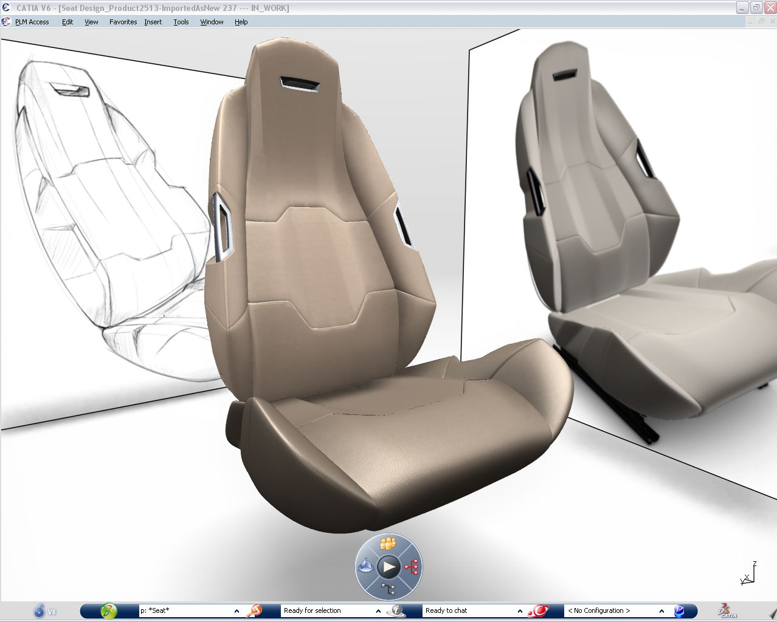
Virtual Design | CATIA Industrial Designers
  Industrial Design Solution for Concept Modeling & Visualization
Challenges
Today's competitive market requires companies to quickly deliver products with innovative and appealing style and Design. CATIA Concept Design is the foundation solution for Designers to Imagine, Create, Share & Experience their Product Design.
Highlights
Sketch integration
Direct modeling with CATIA Live Shape
Ultra fast modeling with Imagine & Shape Subdivisions surface Technology
Real time High-End Visualization & photorealistic Rendering with MentalRay
Suite of easy to use direct Surfacing modeling tools
Comprehensive set of mechanical surface design features
Instant & Asynchronous collaboration tools to easily share data and ideas
Drafting Generation on multiple views
Export STL files for Rapid prototyping machining
Benefits
Industrial Design workflow solution
Easy integration of 2D stylists' work into a 3D environment
Unleash your creativity, capture innovative ideas and explore multiple variations in a natural way with easy to use and Ultra-fast modeling tools
Convince and accelerate the validation of your design with high end real time visualization and rendering with MentalRay
Take advantage of the complete CATIA Design environment
Quickly share concepts and ideas with powerful collaboration tools
Notes:
1

